Slide 1
Dataanalyse
Bigrams and graphs

Slide 2
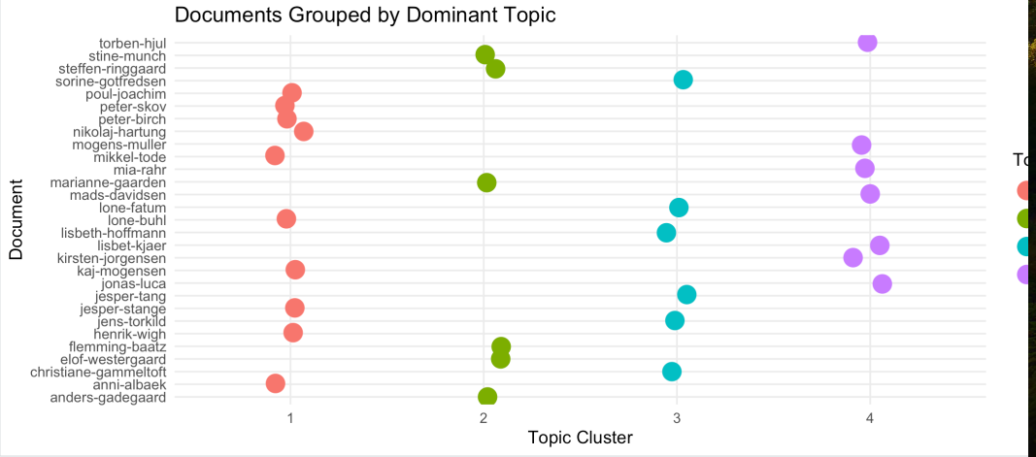
Agenda
Bigrams
Jane Austen
gender-analyse
Network
Eksamensleg I
Find en tekst fra gutenberg
Gennemgå trin
Opdel, optæl
Bigrams,separate,count,filter,viz
Eksamensleg II - Danske prædikener
Wordcount
Sentiment
Wordclouds
Silge og Danske Prædikener
Tag silges ”flow” og overfør til
Danske præster
HC-Andersen

Slide 3
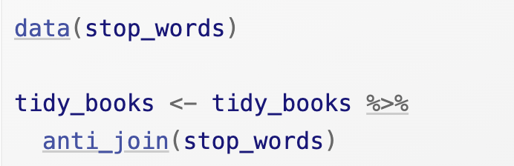
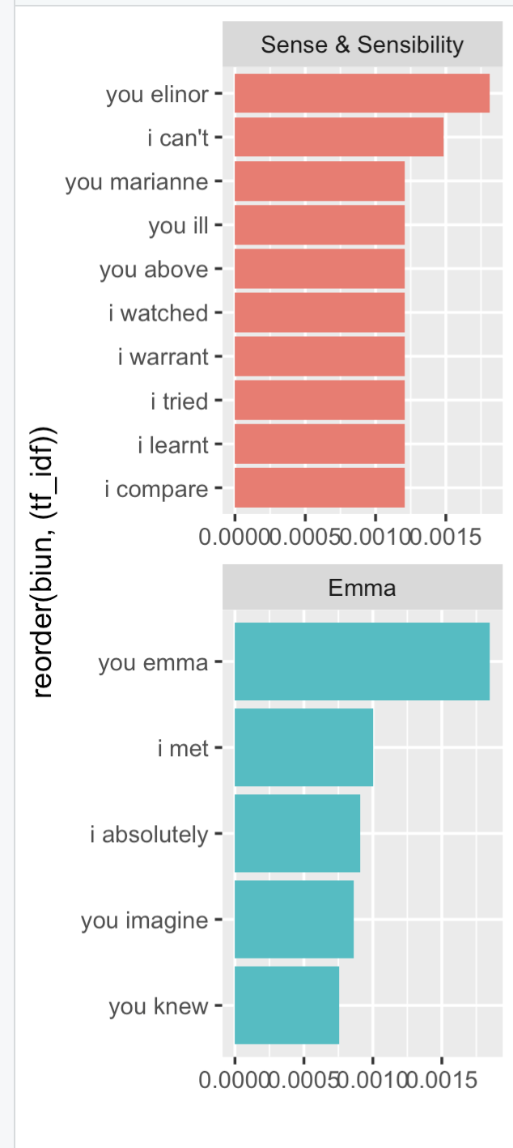
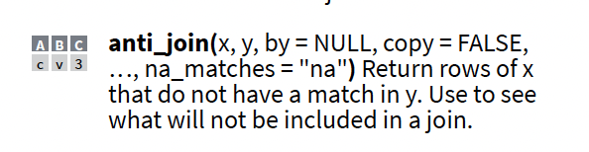
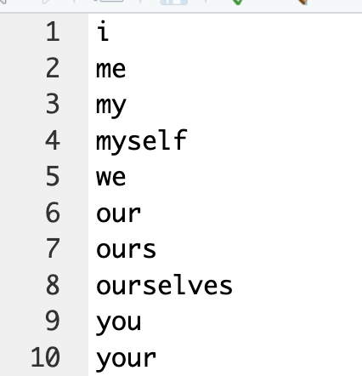
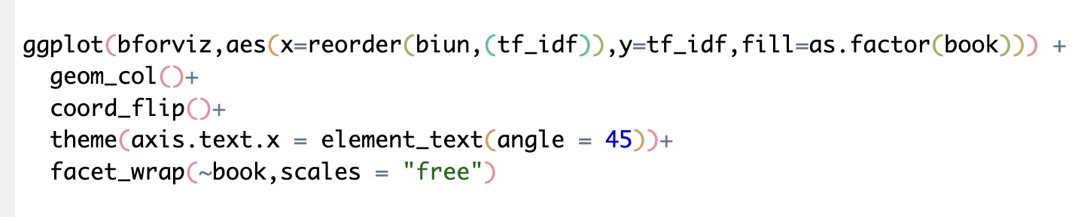
4.1.1 filtering and viz n-grams
Visualisér
Positiv liste
Negative liste

Slide 4
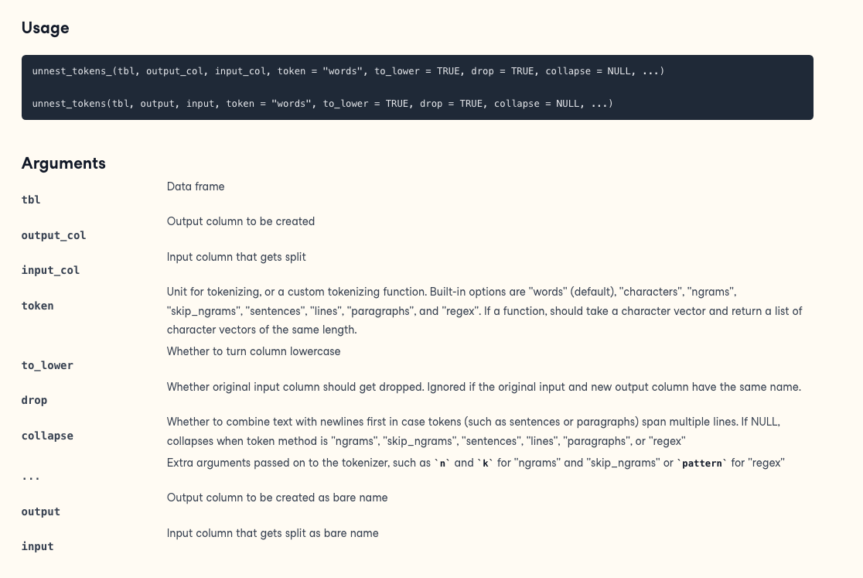
Unnest token

Slide 5
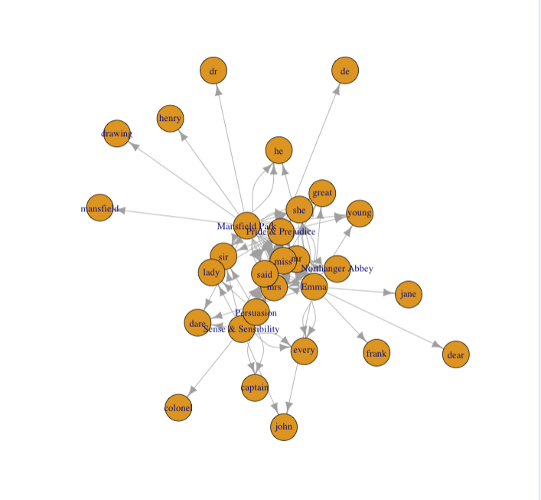
4.1.4 Visualizing a network of bigrams with ggraph
A graph can be constructed from a tidy object since it has three variables:
from: the node an edge is coming from
to: the node an edge is going towards
weight: A numeric value associated with each edge

Slide 6
Silge on Sherlock Holmes
Sentiment

Slide 7
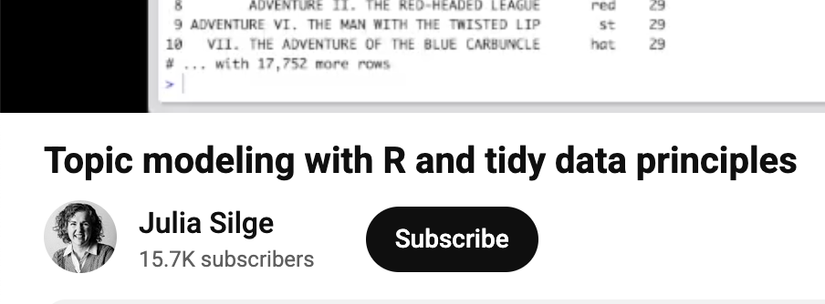
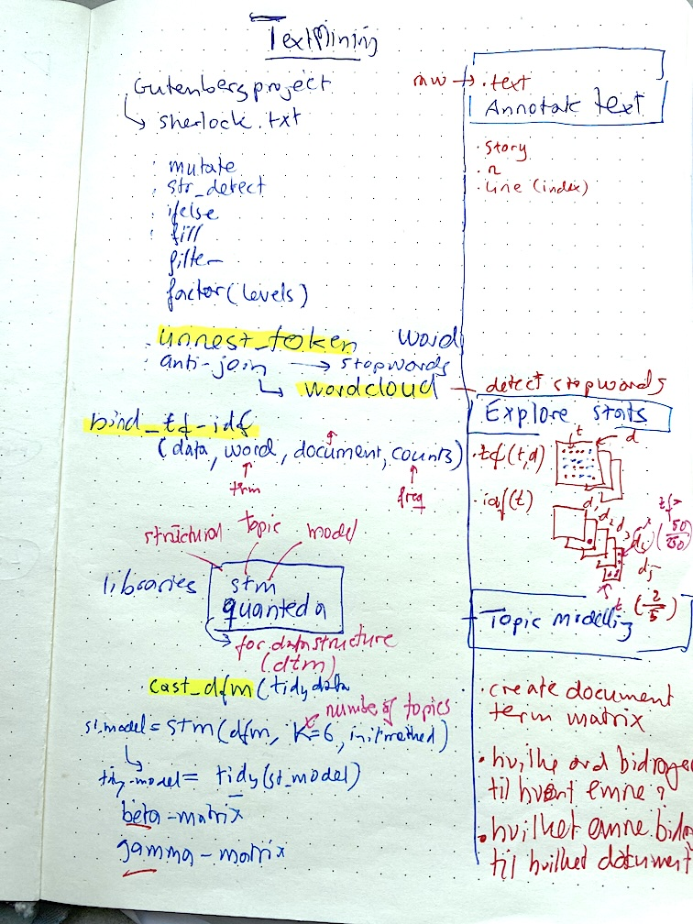
Annotate
Story, count
Explore
Td-idf
Topics
Dtm
tidy

Slide 8
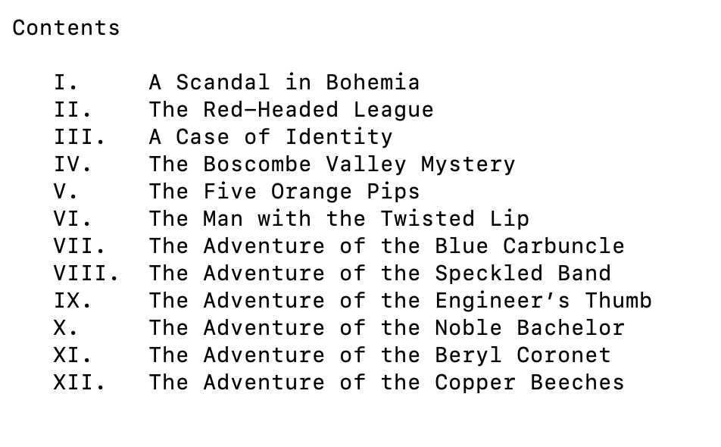
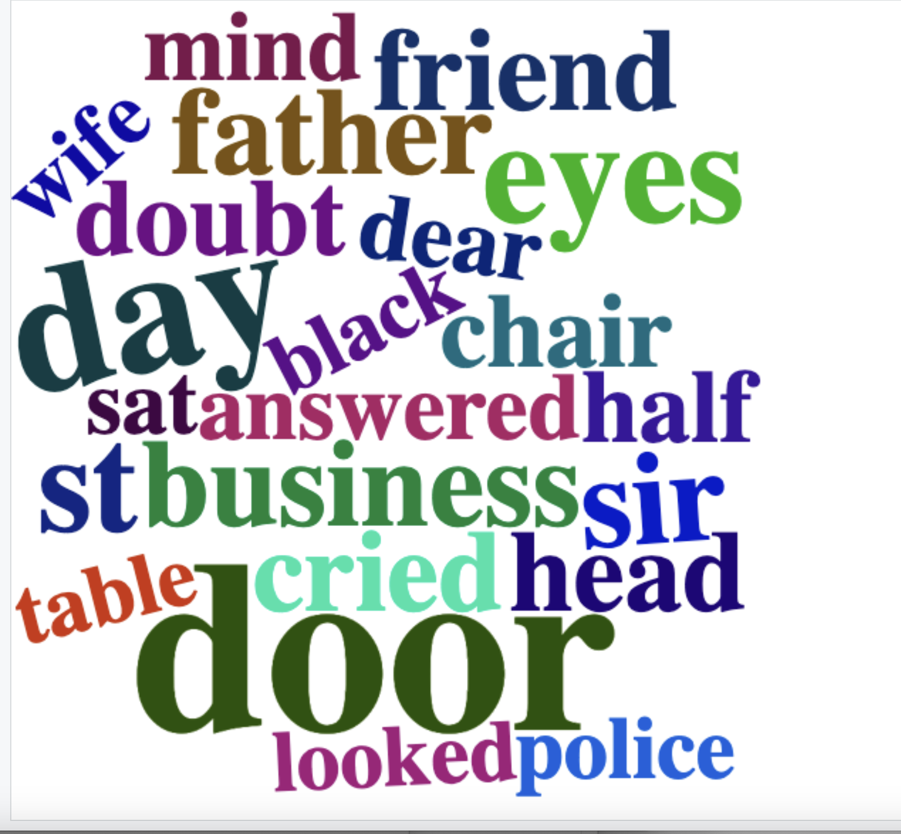
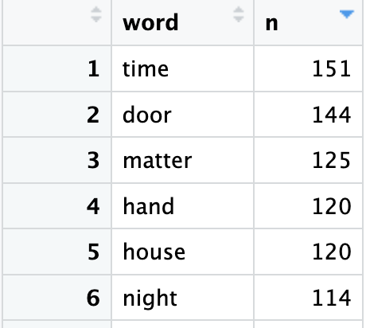
Tokenize and viz

Slide 9
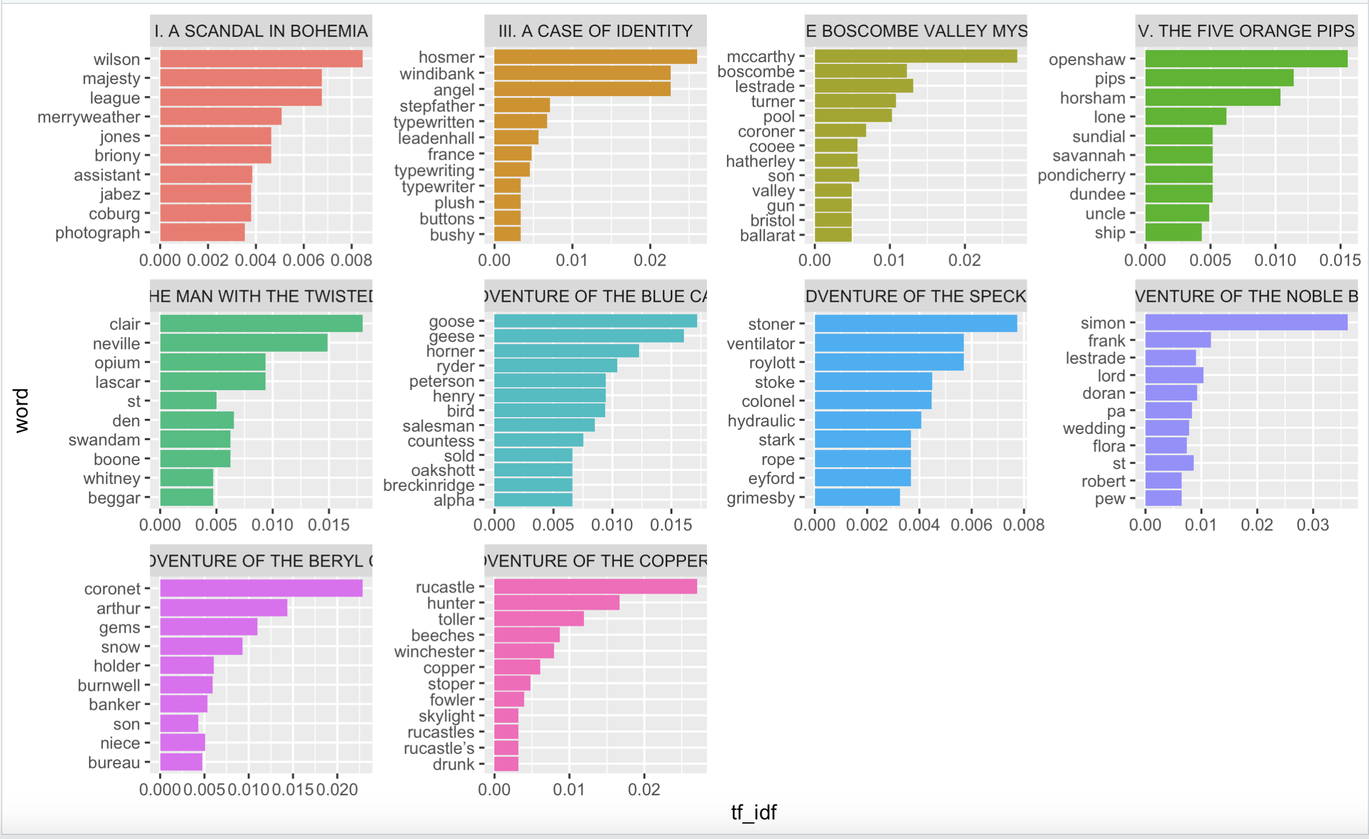
TF-IDF

Slide 10
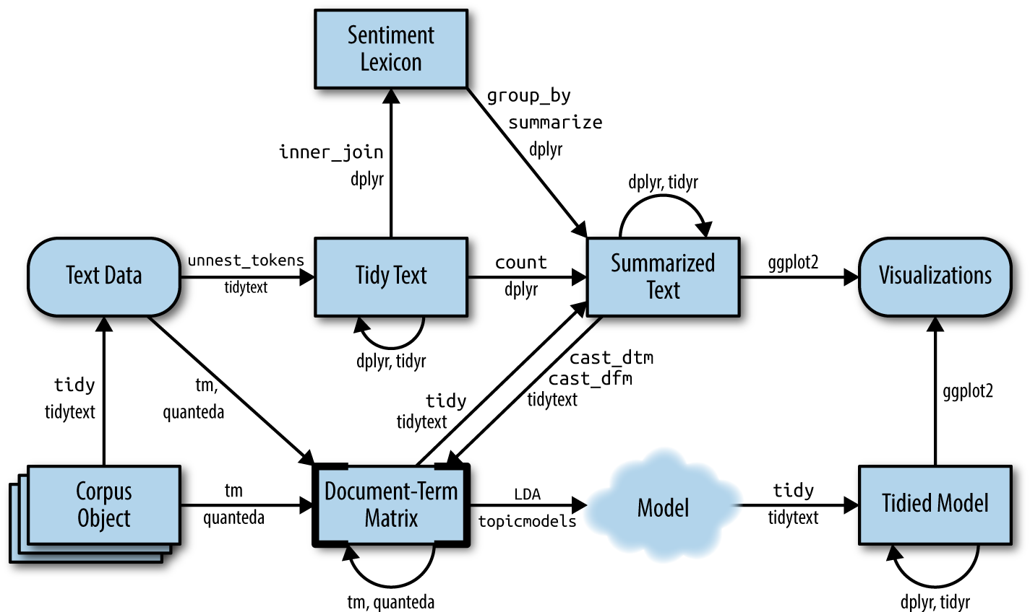
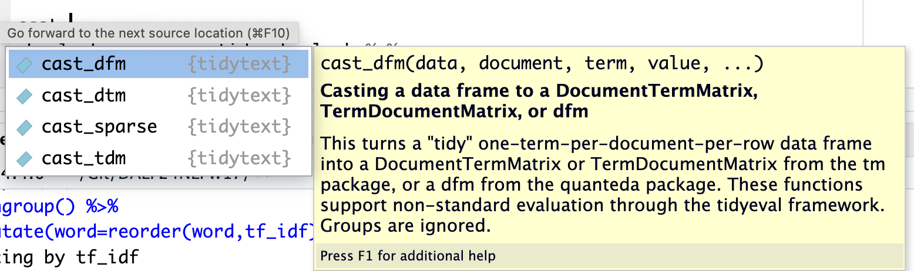
TOPIC MODELLING

Slide 11

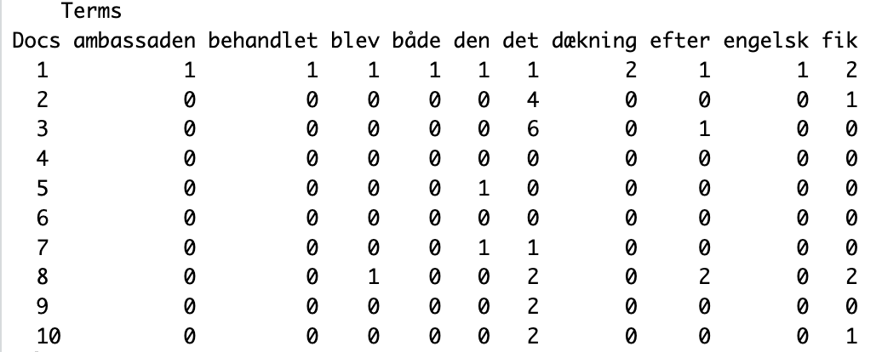
DTM- Quanteda

Slide 12
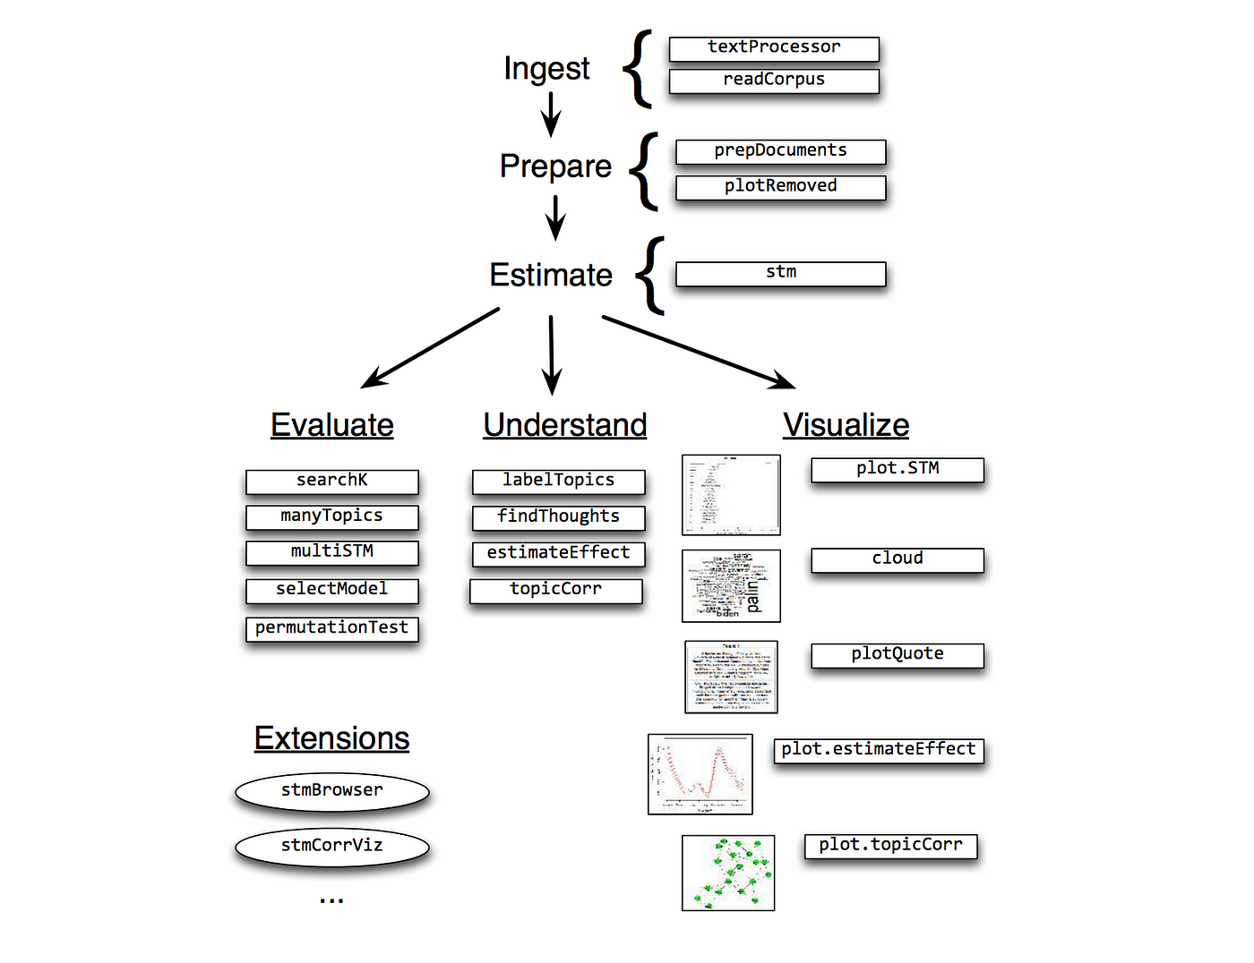
STM

Slide 13
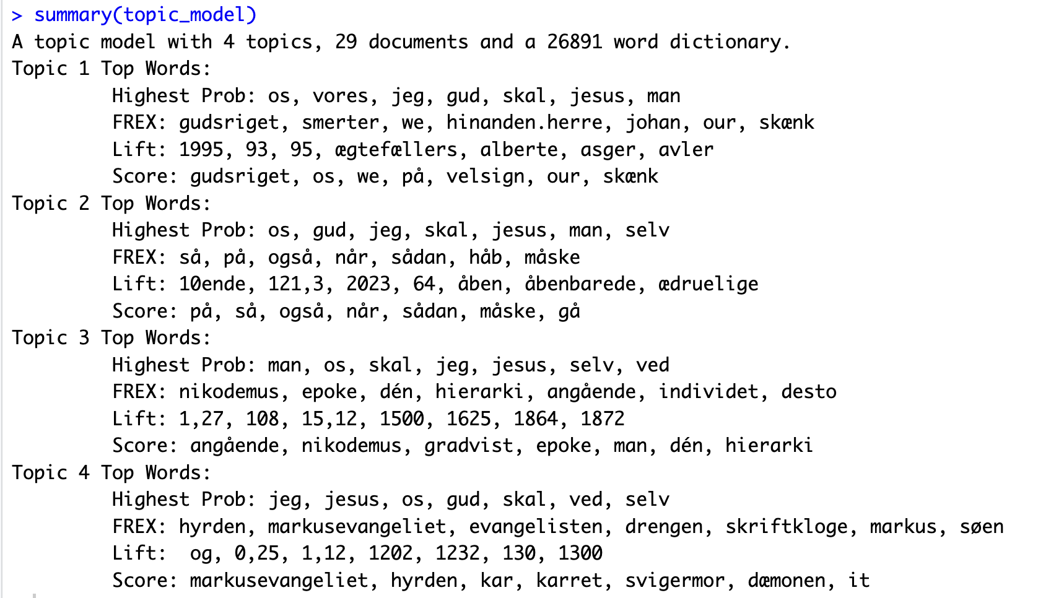

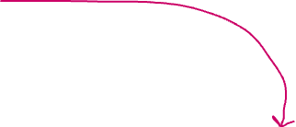






Højest prop i emnet men kan også forekomme i de andre
Løfter sjældne corpus-ord op i dette emne, hvor de forekommer lidt mindre sjældent
Frequent and exclusive. Siger mest om hvad præcist dette emne er om
semantic coherence and exclusivity— blander hyppighed og raritet. Kan bruges til at navngive emnet

Slide 15
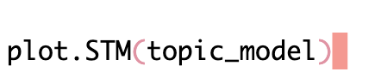
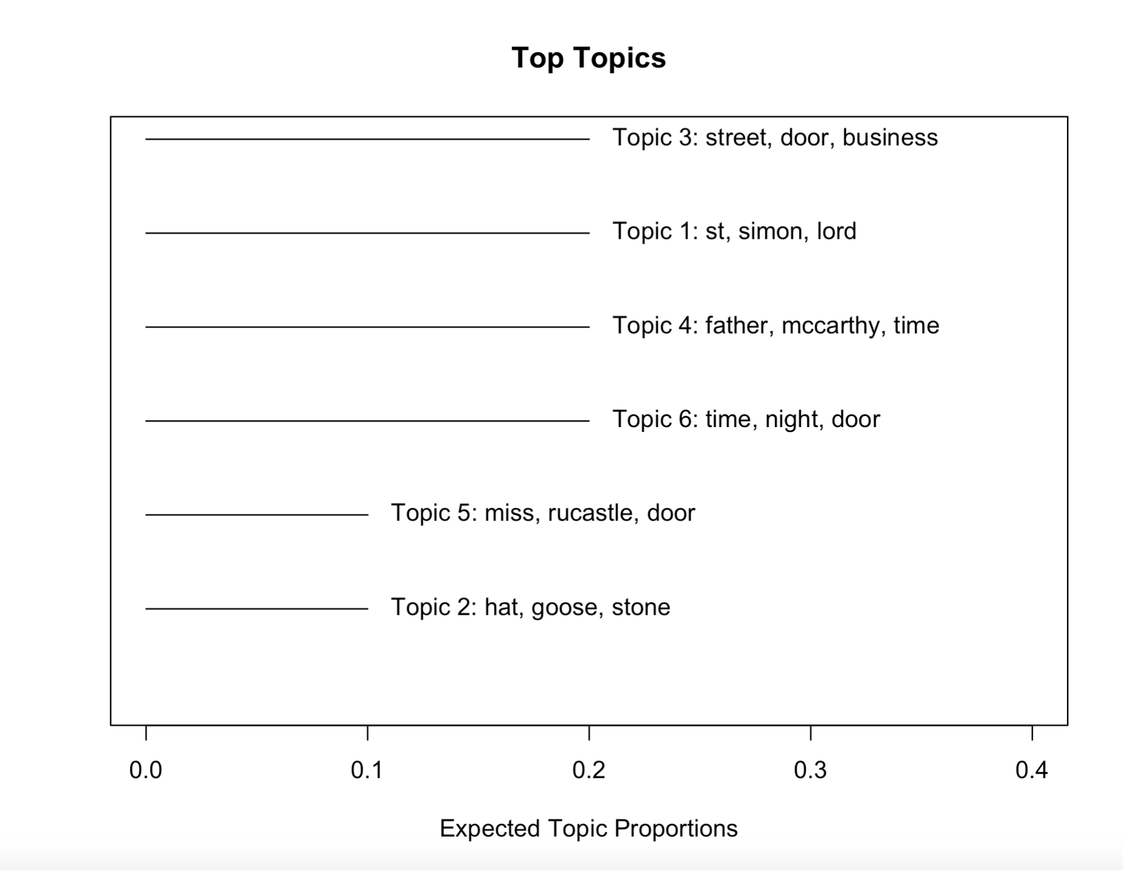

Slide 16
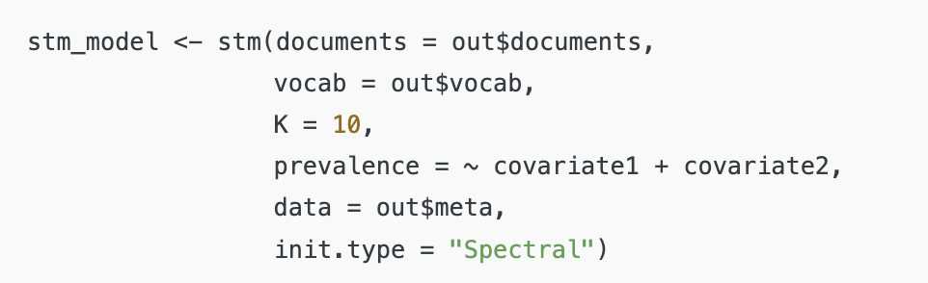
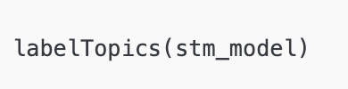
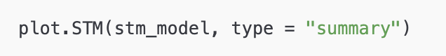
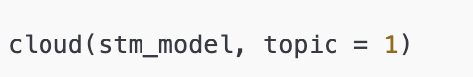
STM

Slide 18
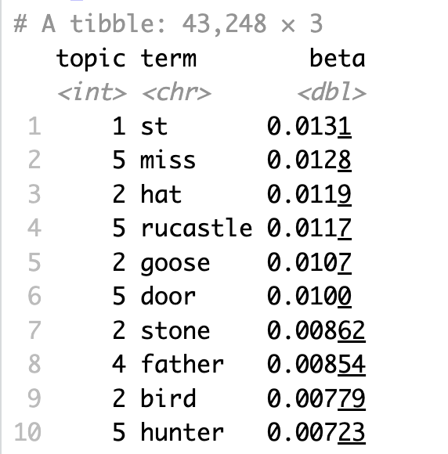
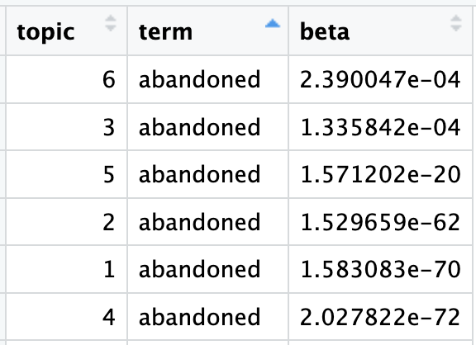
BETA
The tidytext package provides this method for extracting the per-topic-per-word probabilities, called β (“beta”), from he model.
the probability of that term being generated
from that topic.

Slide 19
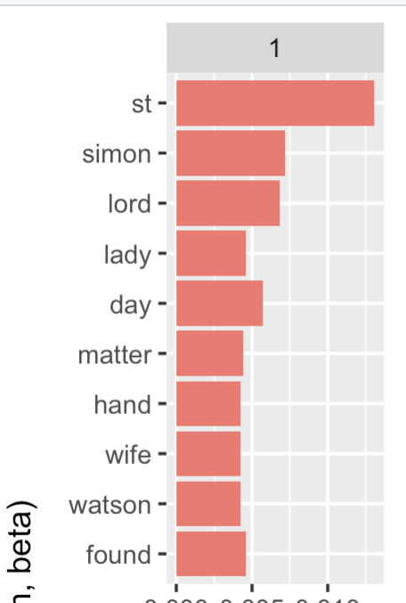
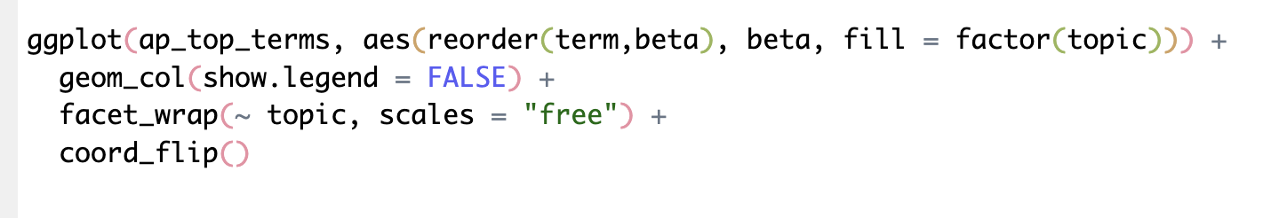
BETA
The tidytext package provides this method for extracting the per-topic-per-word probabilities, called β (“beta”), from the model.
the probability of that term being generated
from that topic.

Slide 20
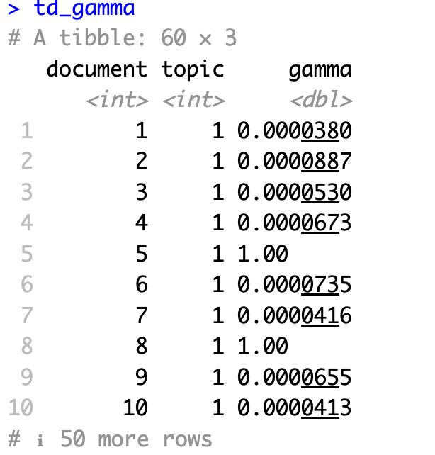
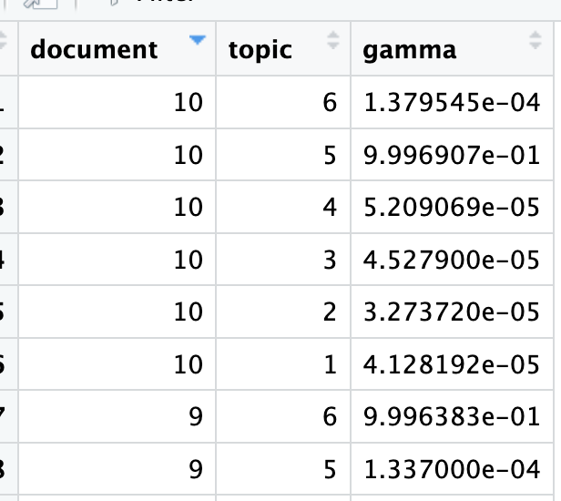
GAMMA
per-document-per-topic probabilities
Each of these values is an estimated proportion of words from that document that are
generated from that topic.
For example, the model estimates that only about 99% of the words in document 10 are generated from topic 5.

Slide 21
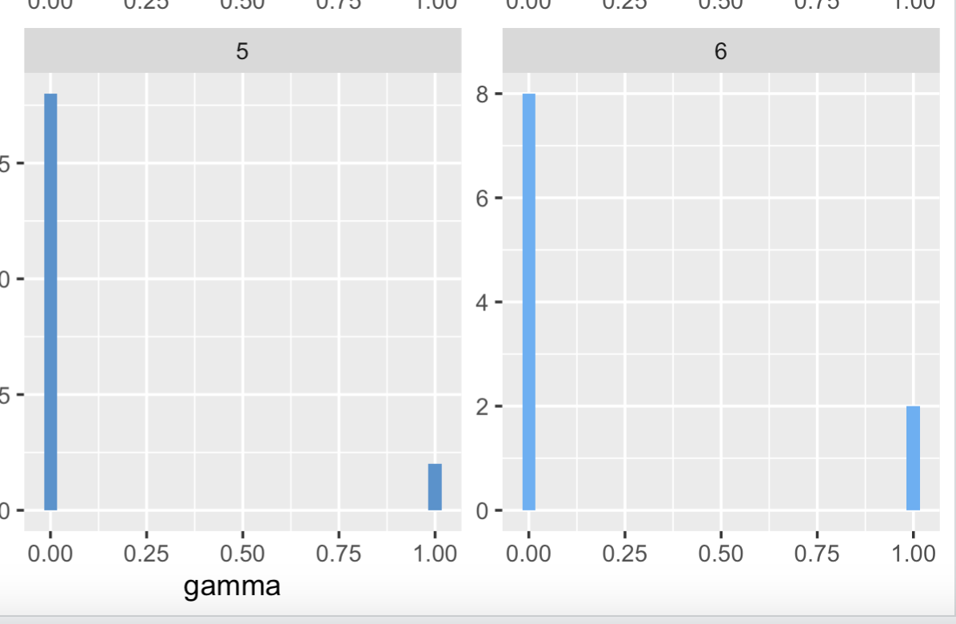
GAMMA
per-document-per-topic probabilities

